Slide 1
CUDA
Memory Model
Hierarchies and bringing it together!

Slide 2

What is Memory?

Slide 3
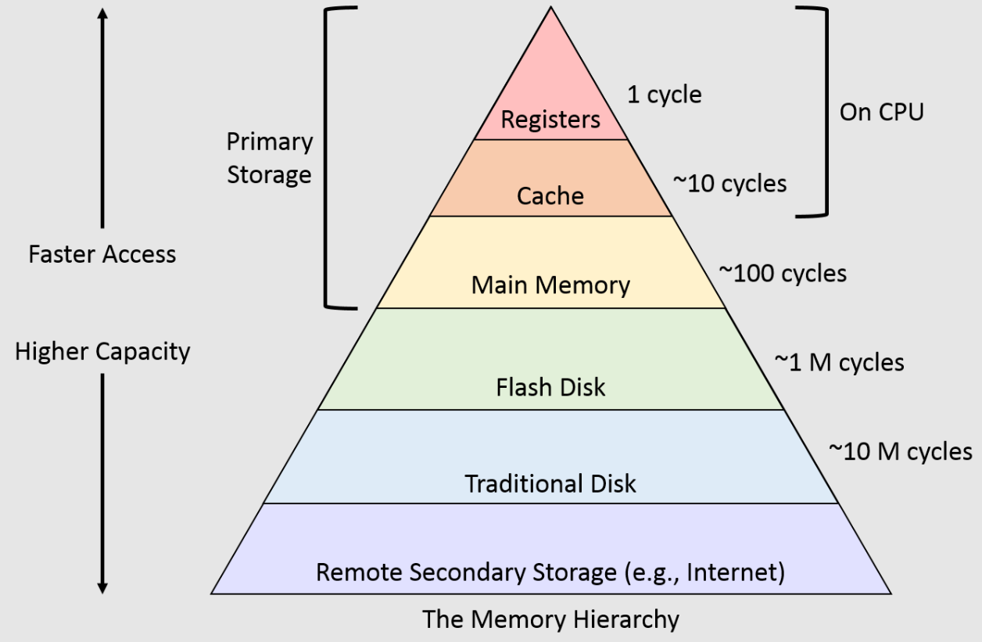
What is a Hierarchy?
A sequence of storage units spaced at different lengths with varying dimensions and manufactured in different technologies

Slide 4
Bringing it to GPUs, what changes?

Slide 5
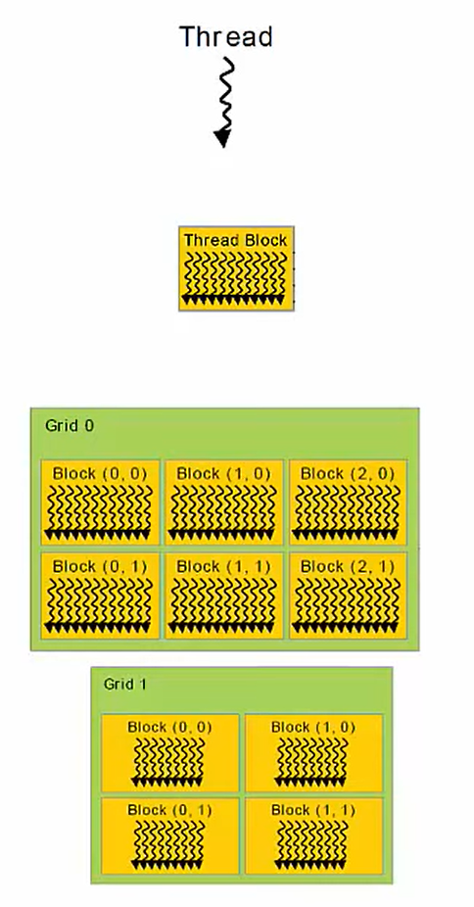
Thread Memory Correspondence
Threads <-> Local Memory (and Registers)
Scope: Private to its corresponding Thread
Lifetime: Thread
Blocks <-> Shared Memory
Scope: Every Thread in the Block has access
Lifetime: Block
Grids <-> Global Memory
Scope: Every Thread in all Grids have access
Entire program in Host code - main ()

Slide 6
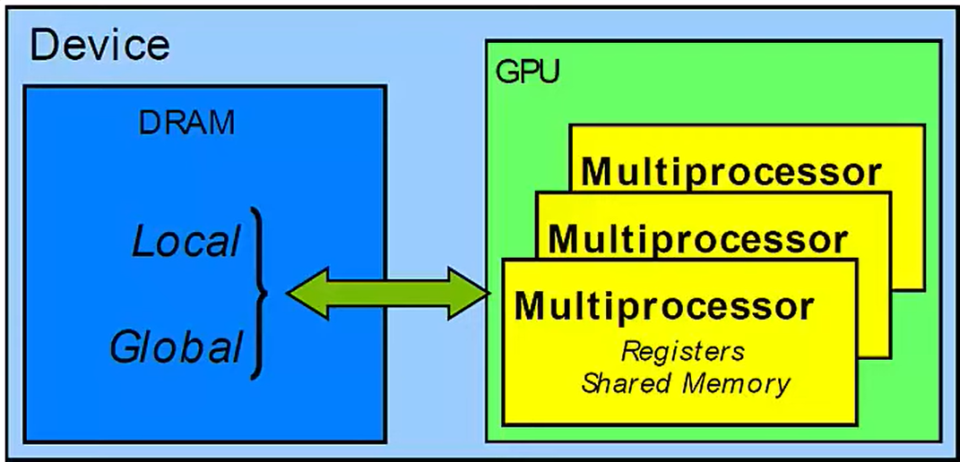
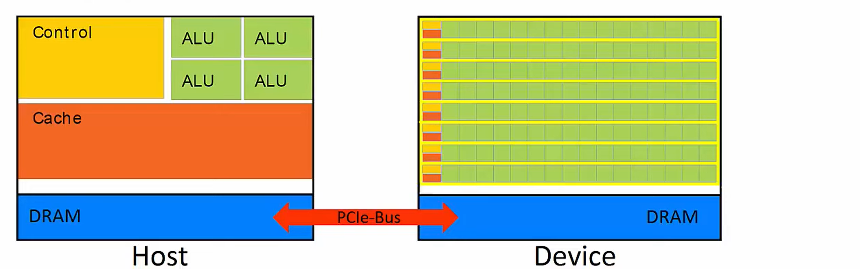
Memory Model
Yellow rectangles represent SM’s
Memory located on SM is called “On-chip” Device memory
Memory not on SM is “Off-chip”

Slide 7

Memory speed
Relative speed of “Memory space” (“bandwidth”/ ”latency”)
Registers < Shared << Local ~ Global << Host (PCIe)
~ 8TB/s ~1.5TB/s ~200GB/s ~5GB/s
1 cycle! 32 cycles! 800 cycles!

Slide 8
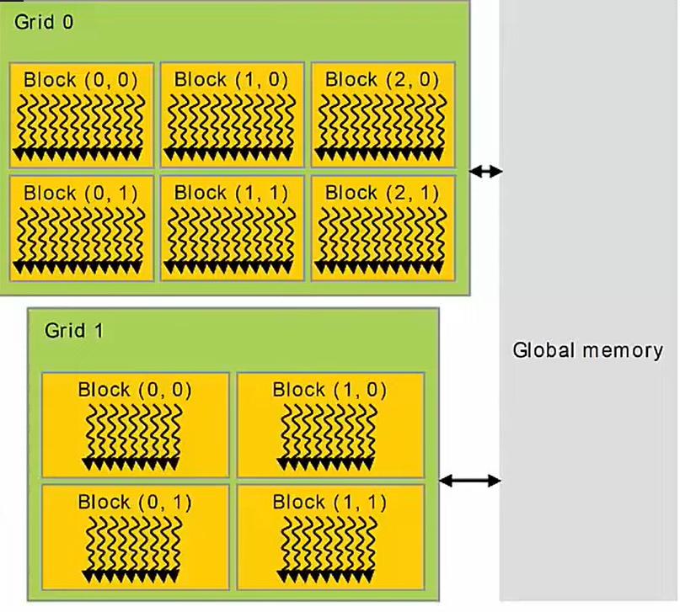
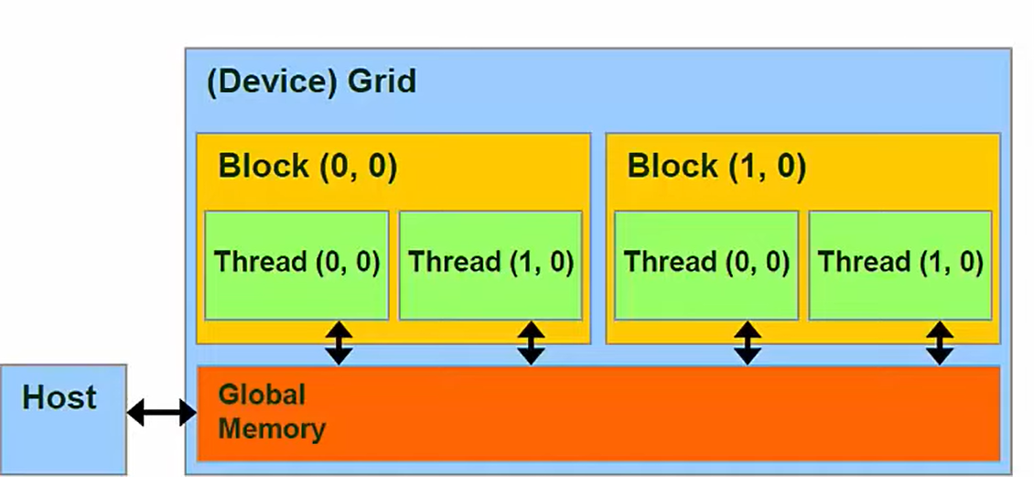
Global Memory
Accessed with:
cudaMalloc()
cudaMemset()
cudaMemCpy()
cudaFree()

Slide 9
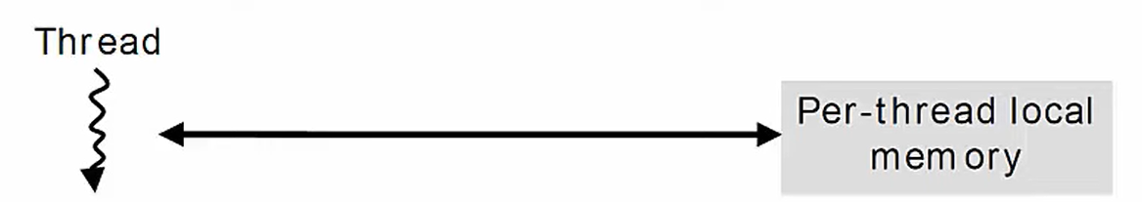
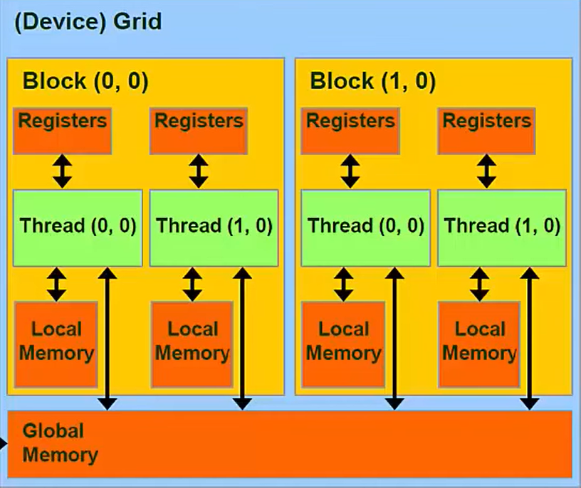
Registers and Local Memory
Variables declared in a Kernel are stored in Registers:
“On-Chip” Fastest form of memory!
Arrays too large to fit into Registers spill over into Local Memory:
Off-chip
Compiler controlled
“Local” refers to scope, not location

Slide 10
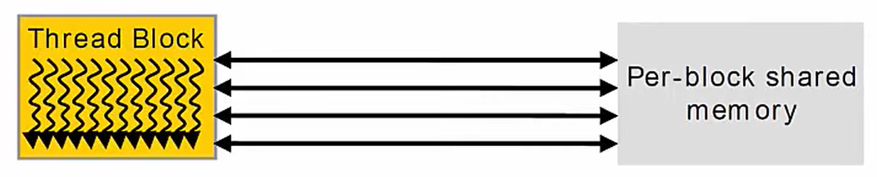
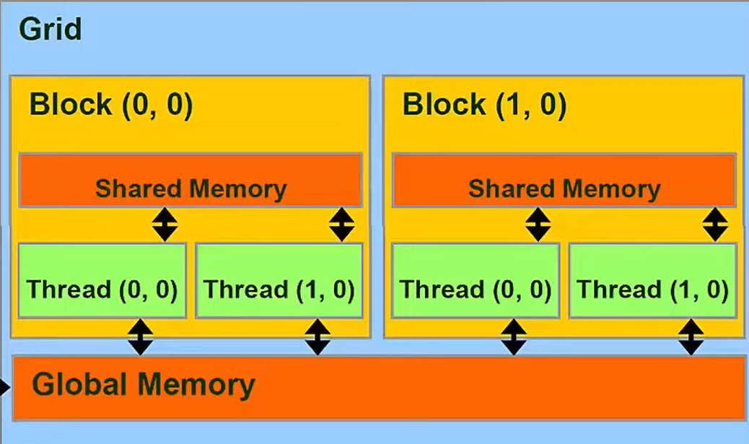
Shared Memory
Allows threads within a block to communicate with each other, use synchronization!
Very fast! Only Registers are faster :0
Can use as “scratchpad” memory

Slide 11
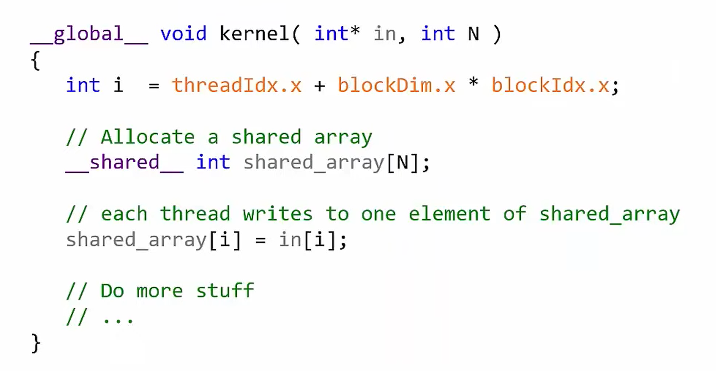
Using Shared Memory

Slide 12
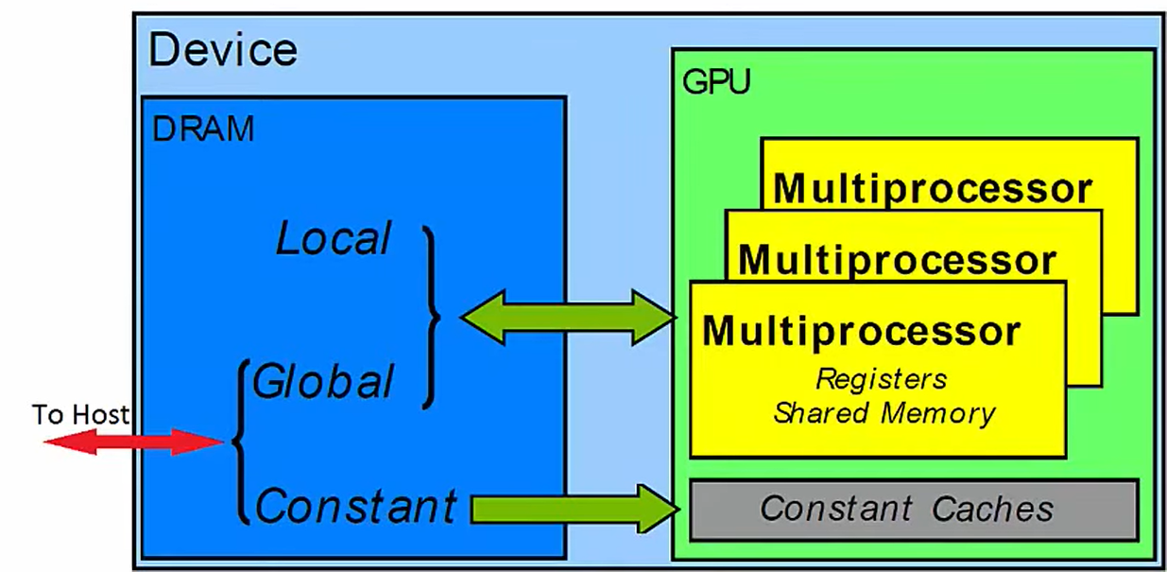
Constant Memory
Special Region of Device Memory
Used for data with unchanging contents throughout kernel execution
Read-only from Kernel
Off-Chip
Constant memory is aggressively cached into On-Chip memory

Slide 13
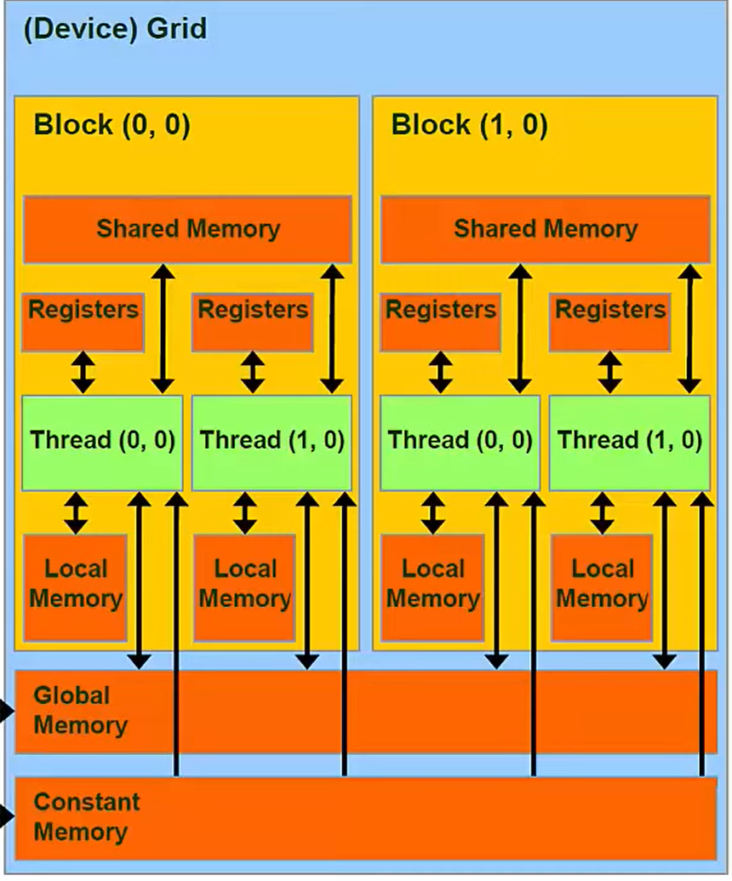
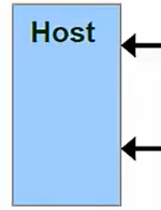
Summary
Registers & Local Memory
Regular variables declared within a Kernel
Shared Memory
Allows threads within a block to communicate
Constant
Used for unchanging data through Kernel
Global Memory
Stores data copied to and from host

